Slide 1
HTML Forms and Javascript Validation

Slide 2
HTML FORMS
Forms provide a means of submitting information from the client to the server
HTML supports tags for creating forms, however, it does not process the information
Use server-side script to process form information
Server-side script runs on the Web server and receives data from a form and uses it to perform a set of tasks

Slide 3
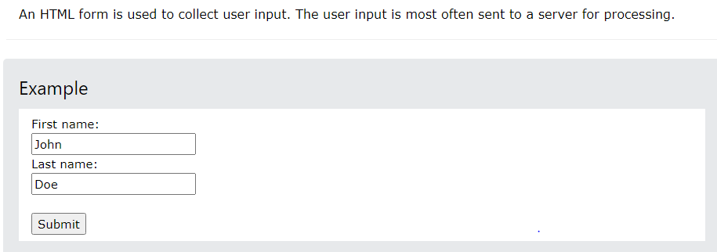
HTML FORMS

Slide 4
HTML FORMS…
Form elements are different types of input elements, like text fields, checkboxes, radio buttons, submit buttons, and more.
<form>
.
.
form elements
.
.
</form>

Slide 5
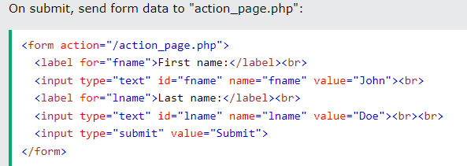
HTML FORM ATTRIBUTES
Action –
The action attribute defines the action to be performed when the form is submitted.
Usually, the form data is sent to a file on the server when the user clicks on the submit button.

Slide 6
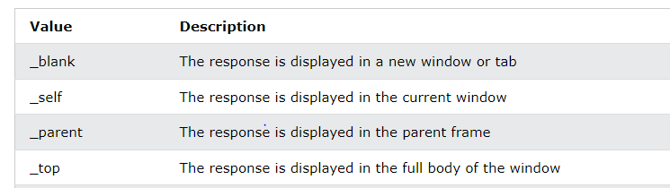

1. HTML FORM ATTRIBUTES
TARGET ATTRIBUTE

Slide 7
1. HTML FORMS ATTRIBUTE
Common Form Attributes:
2. method –
The method attribute specifies the HTTP method to be used when submitting the form data.
The form-data can be sent as URL variables (with method="get") or as HTTP post transaction (with method="post").
The default HTTP method when submitting form data is GET.

Slide 8
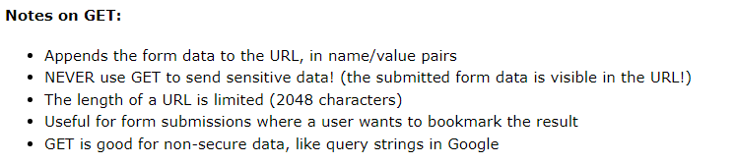
1. HTML FORM METHOD GET VS POST

Slide 9
EXAMPLE
<form action="signin.php" method=“get">
<!-- HTML Form Element -->
</form>
What will be the output
://www.w3schools.com/action_page.php?fname=John&lname=Doe

Slide 10
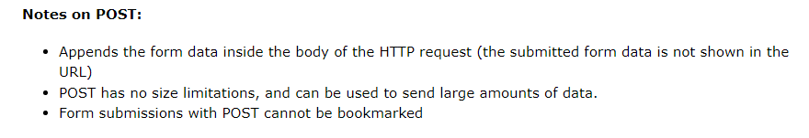
1. HTML FORM METHOD GET VS POST

Slide 11
EXAMPLE
<form action="signin.php" method="post“ target=“_self”>
<!-- HTML Form Element -->
</form>
output is shown as
://www.w3schools.com/action_page.php

Slide 12
HTML FORM ELEMENTS

Slide 13
The <input> Element
The <input> element is the most important form element.
The <input> element can be displayed in several ways, depending on the type attribute. Here are some examples:
Type | Description
<input type="text"> | Defines a one-line text input field
<input type="radio"> | Defines a radio button (for selecting one of many choices)
<input type="submit"> | Defines a submit button (for submitting the form)
<input type="checkbox"> | Defines a checkbox

Slide 14

Input Type Text
<input type="text"> defines a one-line text input field:
<form>
First name:<br>
<input type="text" name="firstname"><br> Last name:<br>
<input type="text" name="lastname">
</form>

Slide 15

<label> Element
The <label> element defines a label for several form elements
The for attribute of the <label> tag should be equal to the id attribute of the <input> element to bind them together.

Slide 16
Text Input (type=“text”)
Example 1: A text field named "text1" that is 30 characters wide.
<input type="text" name="text1" size="30">
Example 2: A text field named "text2" that is 30 characters wide but will only accept 20 characters.
<input type="text" name="text2" size="30" maxlength="20">
Example 3: A text field named "text3" that is 40 characters wide with default value.
<input type="text" name="text3" size="40" value="We are not alone">

Slide 17

Input Type Password
<input type="password"> defines a password field:
The characters in a password field are masked (shown as asterisks or circles).
<form>
User name:<br>
<input type="text" name="username"><br> User password:<br>
<input type="password" name="psw">
</form>

Slide 18
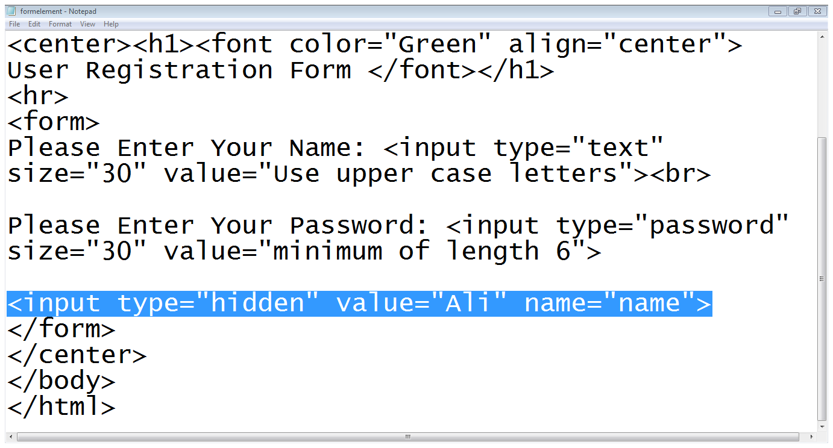
Hidden Text Field…
Type is hidden

Slide 19
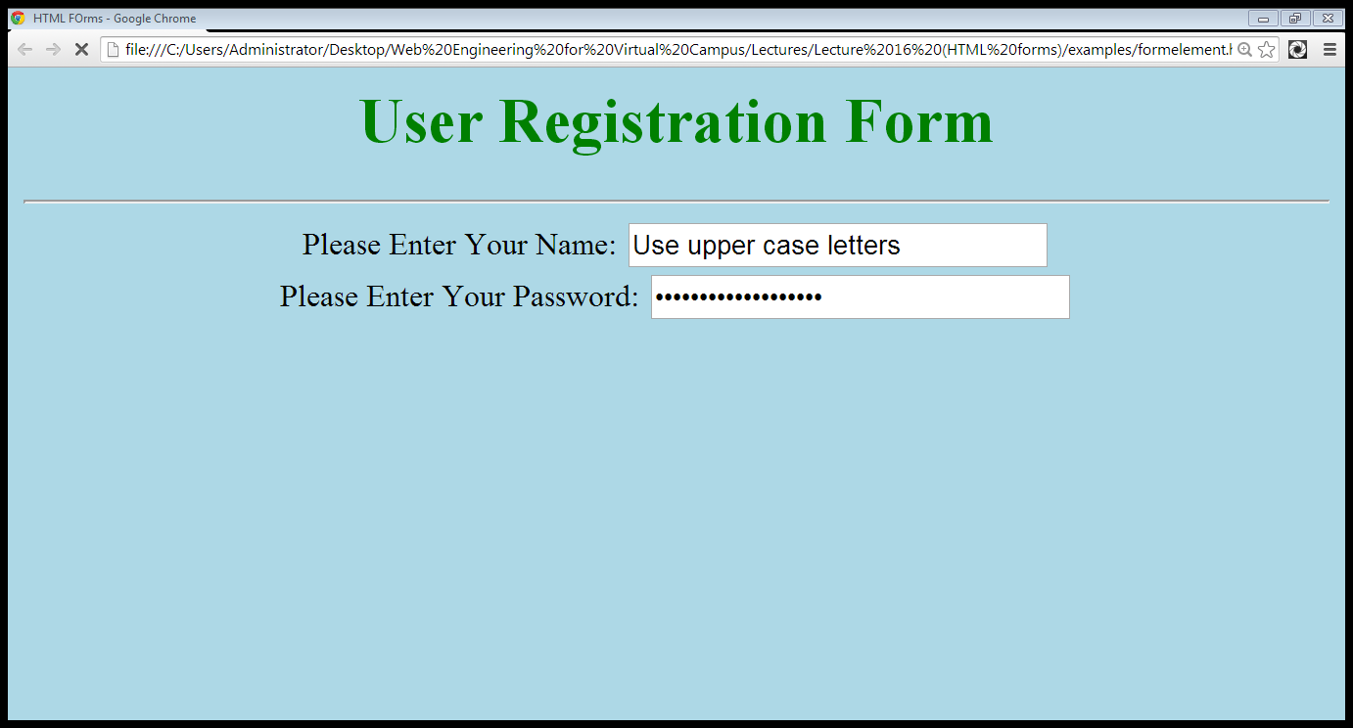
Hidden Text Field…
Hidden field is not visible

Slide 20
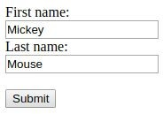
Input Type Submit
<input type="submit"> defines a button for submitting form data to a
form-handler.
The form-handler is typically a server page with a script for processing input data. We will learn this later when we talk about PHP.
<form action="/action_page.php"> First name:<br>
<input type="text" name="firstname" value="Mickey"><br>
Last name:<br>
<input type="submit" value="Submit">
</form>

Slide 21
Input Type Reset
<input type="reset"> defines a reset button that will reset all form values to their default values:

Slide 22

Input Type Radio
<input type="radio"> defines a radio button.
Radio buttons let a user select ONLY ONE of a limited number of choices:
<form>
<input type="radio" name="gender" value="male" checked> Male<br>
<input type="radio" name="gender" value="female"> Female<br>
<input type="radio" name="gender" value="other"> Other
</form>

Slide 23

Input Type Checkbox
<input type="checkbox"> defines a checkbox.
Checkboxes let a user select ZERO or MORE options of a limited number of choices.
<form>
<input type="checkbox" name="vehicle1" value="Bike"> I have a bike<br>
<input type="checkbox" name="vehicle2" value="Car"> I have a car
</form>

Slide 24
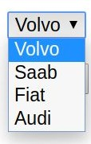
The <select> Element
The <select> element defines a drop-down list
The <option> elements defines an option that can be selected. By default, the first item in the drop-down list is selected.
<form>
<select name="cars">
<option value="volvo">Volvo</option>
<option value="audi">Audi</option>
</select>
</form>

Slide 25

The <select> Element
To define a pre-selected option, add the selected attribute to the option
<form>
<select name="cars">
<option value="volvo">Volvo</option>
<option value="fiat" selected>Fiat</option>
</select>
</form>

Slide 26

The <select> Element
Use the multiple attribute to allow the user to select more than one value: Use the size attribute to specify the number of visible values:
<form>
<select name="cars" size="3" multiple>
<option value="volvo">Volvo</option>
<option value="saab">Saab</option>
<option value="fiat">Fiat</option>
<option value="audi">Audi</option>
</select>
</form>

Slide 27
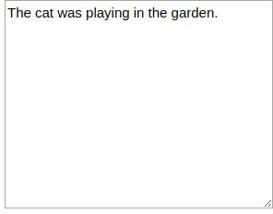
The <textarea> Element
The <textarea> element defines a multi-line input field (a text area)
The rows attribute specifies the visible number of lines in a text area. The cols attribute specifies the visible width of a text area.
<form>
<textarea name="message" rows="10" cols="30"> The cat was playing in the garden.
</textarea>
</form>
You can also define the size of the text area by using CSS properties width and height

Slide 28
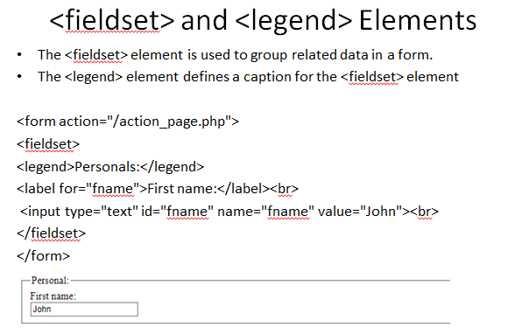

Slide 29
HTML Input Attributes

Slide 30
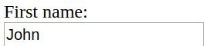
The value Attribute
The value attribute specifies the initial value for an input field:
<form>
First name:<br>
<input type="text" name="firstname" value ="John">
<br>
</form>

Slide 31
The readonly Attribute
The readonly attribute specifies that the input field is read only (cannot be changed):
<form>
First name:<br>
<input type="text" name="firstname" value ="John" readonly>
<br>
</form>

Slide 32
The disabled Attribute
The disabled attribute specifies that the input field is disabled.
A disabled input field is unusable and un-clickable, and its value will not be sent when submitting the form

Slide 33
The size Attribute
The size attribute specifies the size (in characters) for the input field:
<form>
First name:<br>
<input type="text" name="firstname" value="John" size="40">
</form>

Slide 34
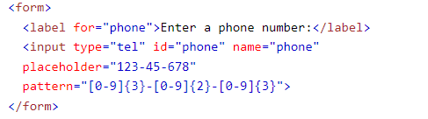
Placeholder attribute
The input placeholder attribute specifies a short hint that describes the expected value of an input field (a sample value or a short description of the expected format).
The short hint is displayed in the input field before the user enters a value

Slide 35
Required attribute
<input type="text" id="username" name="username" required>

Slide 36
Example
Create a form embedded in a table

